Slide 1
THE JOURNEY FORWARD
FUTURE OF THE FINANCIAL SECTOR

Slide 2
Changes in the financial sector
Regulation
Globalisation
New players
Lending and financing
Cross-sector conglomeration
Digitalisation
Other players
Changes in saving and investing
Insurance
Customer behaviour
Payments
Customers
Profitability
Results
Jobs

Slide 3
Background and Goals
Project aim: giving labour market organisations a stronger shared vision on the future of the sector, its upcoming changes, and the required adaptive measures.
Shared vision and agreed measures are used to foresee changes, improve work well-being, and increase productivity and competitiveness. This work stems from the changes in customer behaviour and digitalisation.
Project also identified concrete tools companies can use to improve different areas of working life.
First emerged as strategic intent stated in labour market negotiations 2013.
Made possible by
Finnish Work Environment Fund
Working Life 2020
Finnish Innovation Fund Sitra.

Slide 4
Healthy Financial Sector 2014–2015
02–08/2014
Project plan
Funding
1/2015
Survey
New work in the financial sector
3–4/2015
Themed workshops (2)
5/2015
Effects of digitalisation on productivity
09–11/2014
Union-specific workshops (4)
CHOOSING THEMES FOR FURTHER WORK
COMPANY-SPECIFIC WORKSHOPS
FORECASTING THE FUTURE, INVOLVING PARTICIPANTS IN DIALOGUE
Working on the shared vision
Producing information for future work and operations of companies and labour market participants
WORKSHOP SUMMARY
SURVEY REPORT
WORKSHOP SUMMARY
FINAL SEMINAR 3 June 2016
- Managing telework in the financial sector
- Young people’s opinions (two universities of applied sciences)

Slide 5
Utilising the results
Aim: increasing shared understanding between project participants
Main goals
Taking the results to financial companies to help them adapt to future changes and to increase work well-being, productivity and competitiveness.
Producing information for labour market parties to use in negotiations and to improve their operations.

Slide 6
Shared future
Financial sector’s new way of operating
Market changes and new players
Changing customers
Changing work, new skill requirements
Work well-being and leadership
Productivity, competitive-ness and new operating models

Slide 7
New way of operating
More dialogue needed on both labour market and company levels
Trust and openness are crucial
Shared and neutral discussion forum is needed
Companies can utilise tools identified in the project
Themes of future co-operation: forecasting, innovation, development, geographical concentration of financial competence

Slide 8
New way of operating
Unions
Companies
1–3 y
Continuing work according to the Healthy Financial Sector project model, all employees involved in development
Continuing work according to the Healthy Financial Sector project model, aim at continuous approach
3–5 y
Genuine and open discussion and cooperation culture, development of local negotiations
Genuine and open discussion and cooperation culture
5 y <
Supporting innovation in the sector, networking, concentration of skills
Supporting innovation in the sector, networking, concentration of skills

Slide 9
Market changes and new players
Traditional financial sector
Global players in Finland
Low-cost operators
New technology-based operators
Cross-sector conglomeration
Regulation and fondness of rules
Notes:
Matalan kustannustason toimittajat:
72 % asiakkaille hinta ratkaiseva palvelutoimittajan valinnassa
Uudet teknologiapohjaiset toimijat:
- Digitaaliset ekosysteemit (GoogleApple, Facebook jne)
- Maksu- ja pankkipalvelun tarjoajat (Izettle, Holvi ym.)
- Joukkorahoitus ja vertaislainat (Kickstarter ym.)
Toimialaliukumat:
S-Pankilla 2.7 milj. asiakasta

Slide 10
Market changes and new players
Unions
Companies
1–3 y
Expanding views; recognising best practices also outside the sector
Recognising best practices also outside the sector
3–5 y
Genuine and open discussion and cooperation culture
Genuine and open discussion and cooperation culture
5 y <
Sector-wide innovation program and development of competence; reviewing working methods to allow more innovation
Supporting innovation in the sector, networking, concentration of skills

Slide 11
Changing customers
CHANGING VALUES AND ATTITUDES
Demand for ethicality, responsibility, customer orientation and ease of use
Customer loyalty declining
Easier to shop around
Trust and information security are crucial!
Self-service using information technology and digital channels
Service at the office
Personal individual service in different service channels
Notes:
Ennen palvelu tapahtui konttorissa ja
Nyt sekä tulevaisuudessa teknologia-avusteista itseasiointia sekä yksilöllistä henkilökohtaista palvelua eri kanavissa → 90 % asiakkaista haluaa tätä, toivoen samalla Laajoja palveluaikoja

Slide 12
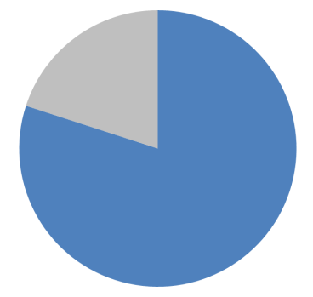
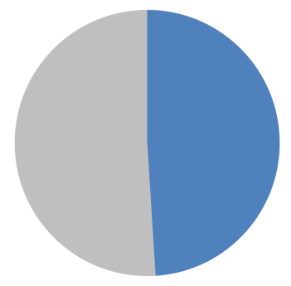
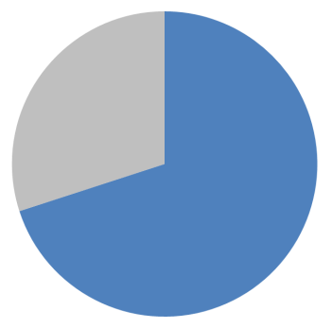
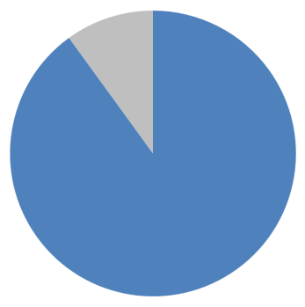
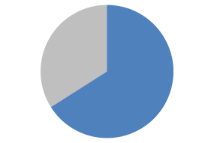
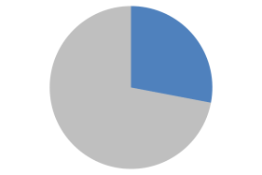
Digitalisation strongly present in customers’ use of services
Nearly
80%
prefer to manage their banking and insurance independently online
49% use banking and insurance services with mobile devices
Over
70%
expect the bank to provide personal assistance for use of digital services
But
90%
want personal service in addition to self-service – either at the office, or by phone, online chat or video call
66%
aged 15–24
28%
aged 65–70

Slide 13
Demand for personal service also during workweek after 4pm and weekends
What times would you like to have access to personal banking and insurance services?
Mihin kellonaikoihin haluaisit saada henkilökohtaista pankki- ja vakuutuspalvelua?
Mon–Fri
Sat
Sun
Source: T-media 2015

Slide 14
Changing customers
Unions
Companies
1–3 y
Improving reputation and attractiveness of the sector; highlighting trustworthiness, ethicality and work well-being
Improving services, change in service culture; customer orientation in service development; improving employer image
3–5 y
Expanding views; recognising best practices also outside the sector.
Developing skills and competence
Recognising best practices also outside the sector
Developing skills and competence
5 y <
Sector-wide innovation program and development of competence; reviewing working methods to allow more innovation
Supporting innovation in the sector, networking, concentration of skills

Slide 15
Changes in work and new skill requirements
Mobile
Multi-location
Virtual
CHANGES
New job descriptions
Telework at home or other places
Diverse teams in multiple locations
Supporting diversity
Heightened importance of leadership
Attractiveness for young people
Employer image
SKILLS
Multi-skill requirement
Based on strong digital skills
Helping and guiding customers; managing their finances as a whole
Sales and customer service
Ethicality and responsibility
Adaptability to change, innovativeness

Slide 16
Changes in work and new skill requirements
Unions
Companies
1–3 y
Improving reputation and attractiveness of the sector; highlighting trustworthiness, ethicality and work well-being
Improving employer image
3–5 y
Developing skills and competence
Shared projects to develop working life
Flexible working models
Renewing leadership models
Handling mobile multi-location work
Supporting mobility and flexibility
Working-hours bank and other flexible means of working
5 y <
Reforming the Working Hours Act
Improving monitoring of work well-being and productivity

Slide 17
Work well-being and leadership
Young people’s expectations of leadership and new attitude to work
Hierarchies
Traditional, static leadership
Coaching, agile leadership that supports change
More diversity and digitalisation in work
Inherited leadership models
Telework and other flexible means of working
Work well-being and capacity
Balance of work and free time
Flexibility of working hours

Slide 18
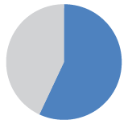
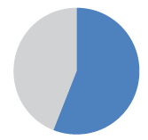
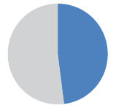
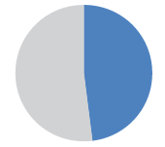
Main factors of future well-being
In your opinion, what are the most important factors of work well-being in the financial and insurance sectors in the future?
Choose 5 at most
57%
Balance between requirements and pay
56%
Good management/ leadership
48%
Balancing work and personal life
47%
Genuinely open working culture
47%
Sensible and motivating goals

Slide 19
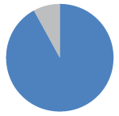
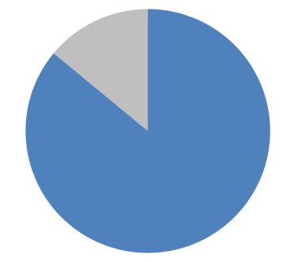
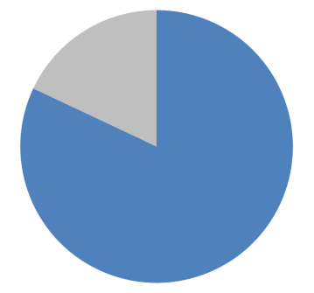
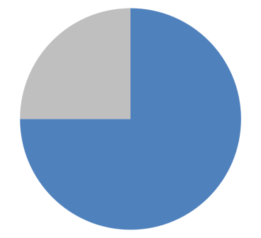
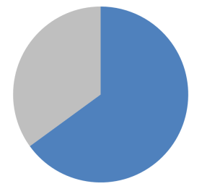
Employees enjoy work and want to develop their competence
92%
The sector offers constant learning opportunities
86%
I am willing to study more to advance my career
82%
Time-related pressure is detrimental for work quality
75%
I would recommend the sector as an employer
66%
The future offers new, exciting jobs
65%
The sector has good working atmosphere
Proportion of respondents who fully agree or somewhat agree with the corresponding statements. T-Media 2015.

Slide 20
Work well-being and leadership
Unions
Companies
1–3 y
Improving work well-being, effect on productivity
Genuine utilisation of existing means of flexible working
3–5 y
Development of skills and competence
Developing culture of local agreements and genuine discussion and cooperation culture
Development of flexible working models for the sector
Reviewing leadership models
Developing skills for new work
(flexible and digital)
Genuine discussion and cooperation culture
Working-hours bank and other flexible means of working; supporting mobility
5 y <
Reforming the Working Hours Act
Improving monitoring of work well-being and productivity

Slide 21
Productivity, competitiveness and new operating methods
Robotisation and automation
Robotisaatio
Robotisaatio
DIGITALISATION
Robotisaatio
ICT SUPPORTS WORK
NEW C2C SERVICES
Robotisaatio
Robotisaatio
Robotisaatio
NEW TASKS NEW SKILL REQUIREMENTS CHANGE IN EXPERTISE

Slide 22
Change in information work
Change
Routine work is digitalised
Some work transferred into customer devices
Background work outsourced to cheaper countries
More face-to-face service with the customer
Source: Matti Lehti

Slide 23
Capacity for renewal and innovation
Requires:
Co-operative development of new skills and competences
New forums for development, cooperation and innovation
Acceptance of diversity and risks
Entrepreneur-like operating model
Customer involvement in product and service development
87% of employees agree:
new methods should be explored bravely!

Slide 24
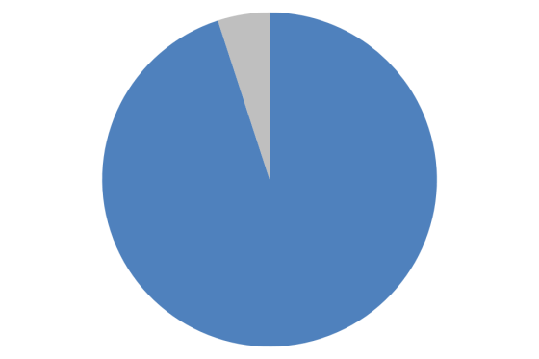
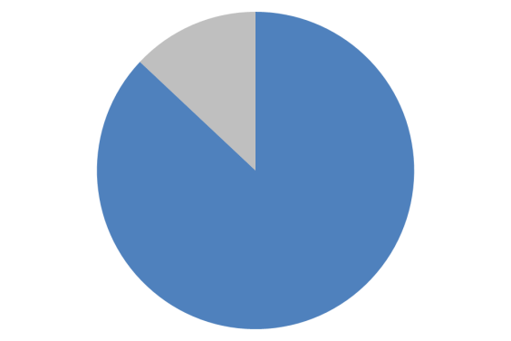
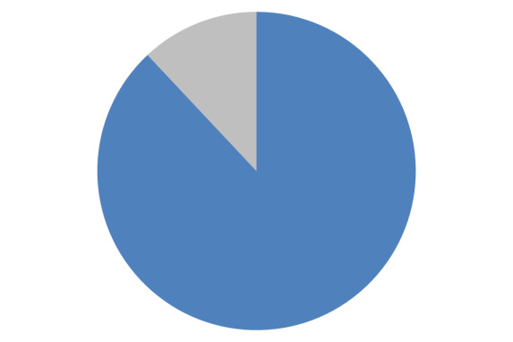
Change as seen by Finnish financial employees
95%
believe that technology-assisted self-service will increase substantially
95%
consider digital know-how an essential skill
nearly equal amount believe the importance of consultative sales will increase
87%
think the sector needs brave exploration of new working methods and should change on the basis of gained experiences
88%
trust information technology makes work easier

Slide 25
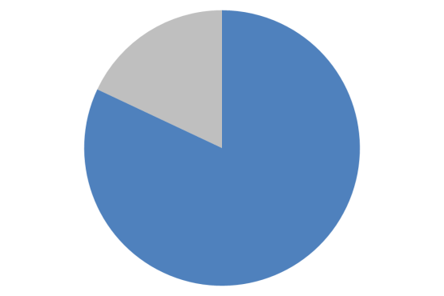
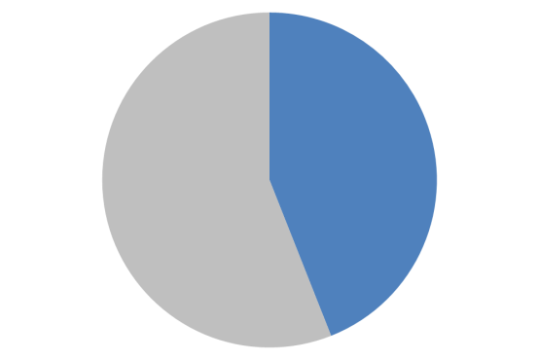
Change as seen by Finnish financial employees
82%
expect they will need the skill to guide customers with new service channels
82%
expect flexible working hours will become more popular
44%
predict robots are an everyday thing in the financial sector in the future

Slide 26
Potential ways for financial companies to survive competition in the digital world
Continuous development of services
Continuous development of employees’ skills and working methods, with main focus on expertise and trust
Responding to customers’ needs for digital services. Establishing a corporate culture of digital services.
Matti Pohjola 2015

Slide 27
Productivity, competitiveness and new operating models
Unions
Companies
1–3 y
Forecasting new competence requirements
Constant development of services and skills
3–5 y
New forums for development, cooperation and innovation; national networking
Acknowledging the effects of robotics and automation, and creating a corporate culture for digital services
5 y <
Sector-wide innovation program and competence development; reviewing working methods to allow more innovation
Ability to adopt new technological innovations by acquiring know-how from or allying with technology companies

Slide 28
Main suggestions for development
1–3 y
Confidential and open dialogue
Continuous co-operation in monitoring developments in the sector
Utilising existing possibilities
Improving the reputation and attractiveness of the sector
Improving work flexibility and leadership
Improving skills
Taking digitalisation into account, developing the corporate culture for providing digital services, customer-orientation
3–5 y
5 y <
Supporting innovation
Reforming the Working Hours Act
Improving monitoring of work well-being and efficiency

Slide 29
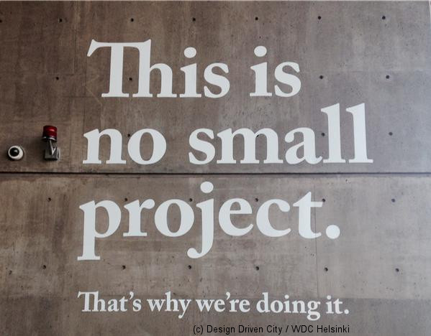
More information: http://www.fkl.fi/en/themes/HyFi/Pages/default.aspx

