Slide 1
Words to Actions
Best practices of Finnish financial sector companies

Slide 2
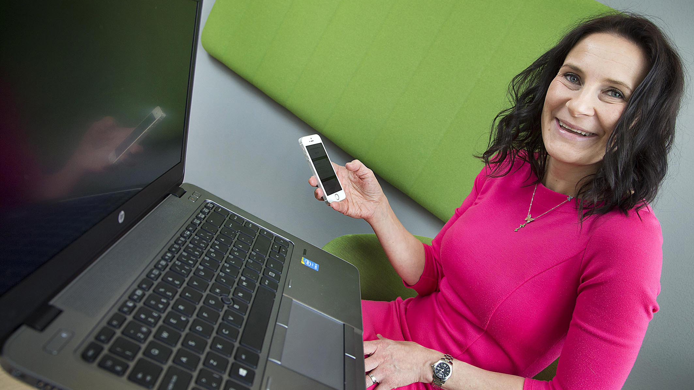
”Every Aktia employee undergoes digital training.”
Aktia Bank plc

Slide 3
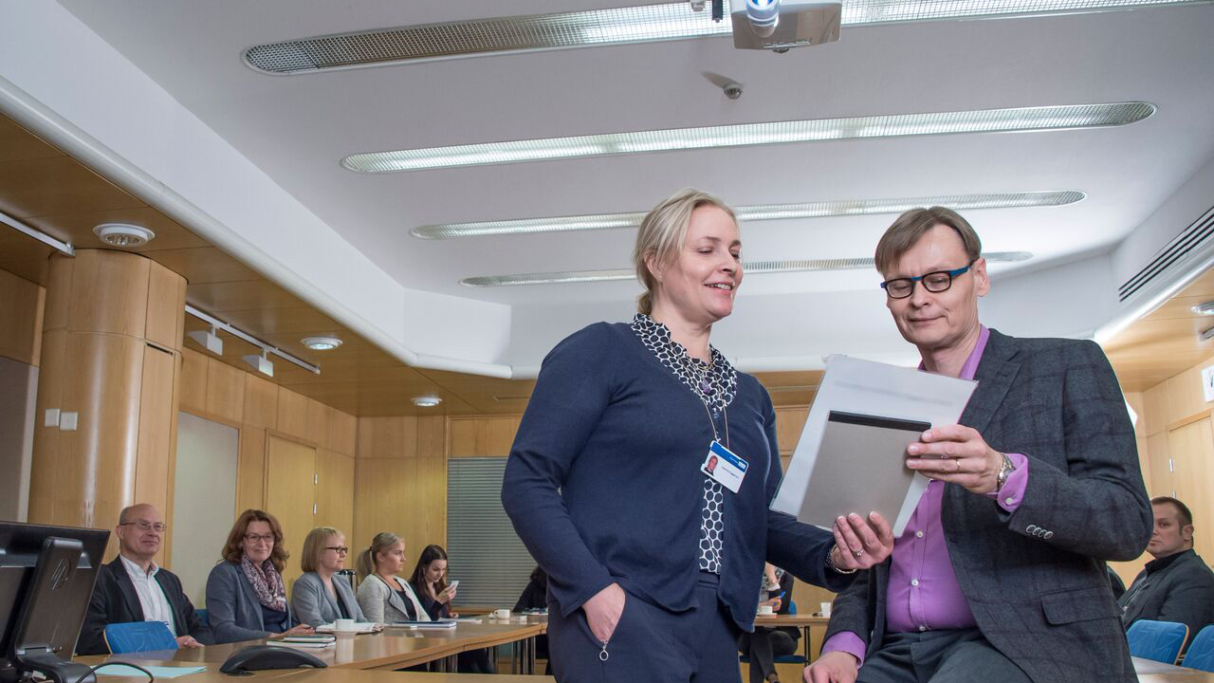
”Working capacity management is part of the daily routine at Danske Bank. Regular training of managers and the support of occupational health care give us the tools to make this possible.”
Danske Bank

Slide 4
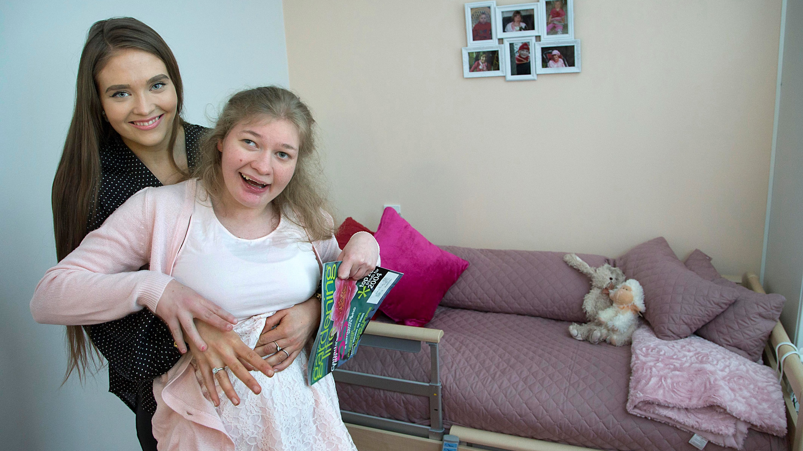
”At Elo, we established a permanent operating model that balances family caregiving and work.”
Elo Pension Insurance

Slide 5
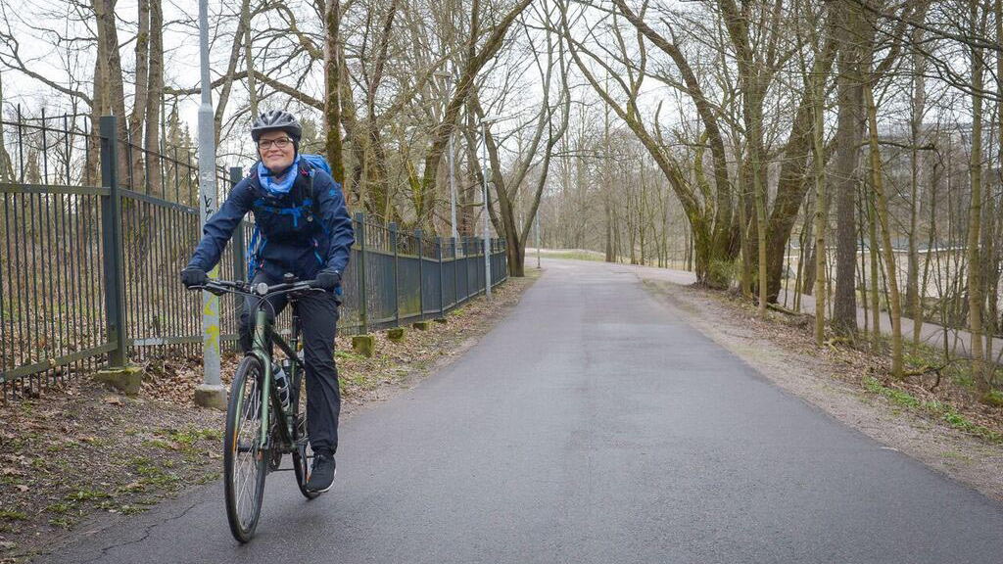
”At Etera we encourage employees to look after their work wellbeing. Walking or biking to work gives a healthy and refreshing boost to everyone’s day.”
Etera Mutual Pension Insurance

Slide 6
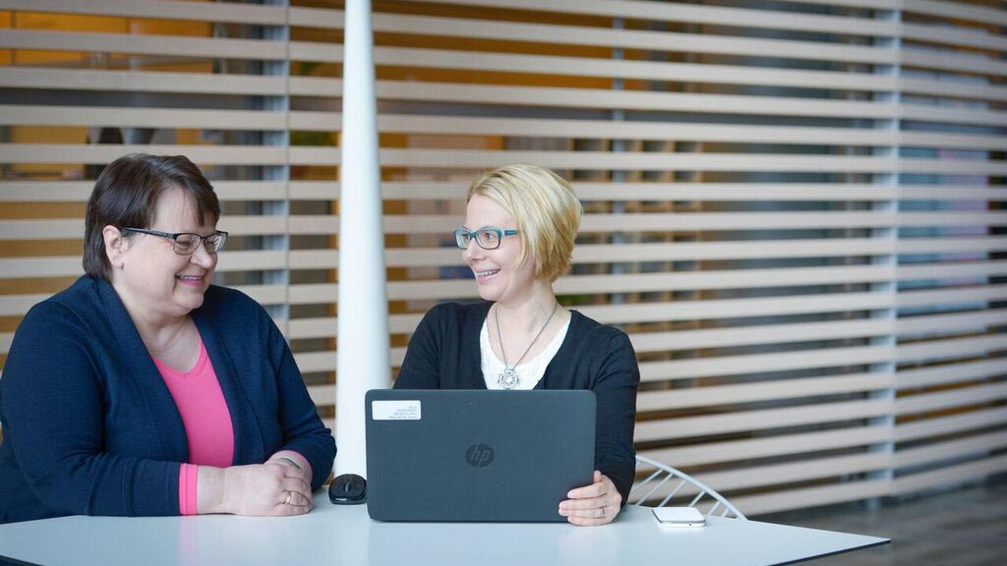
”Fennia has formed an in-house network of experts, who familiarise themselves with major changes in operating models or systems, and then transfer this knowledge onward to their colleagues.”
Fennia

Slide 7
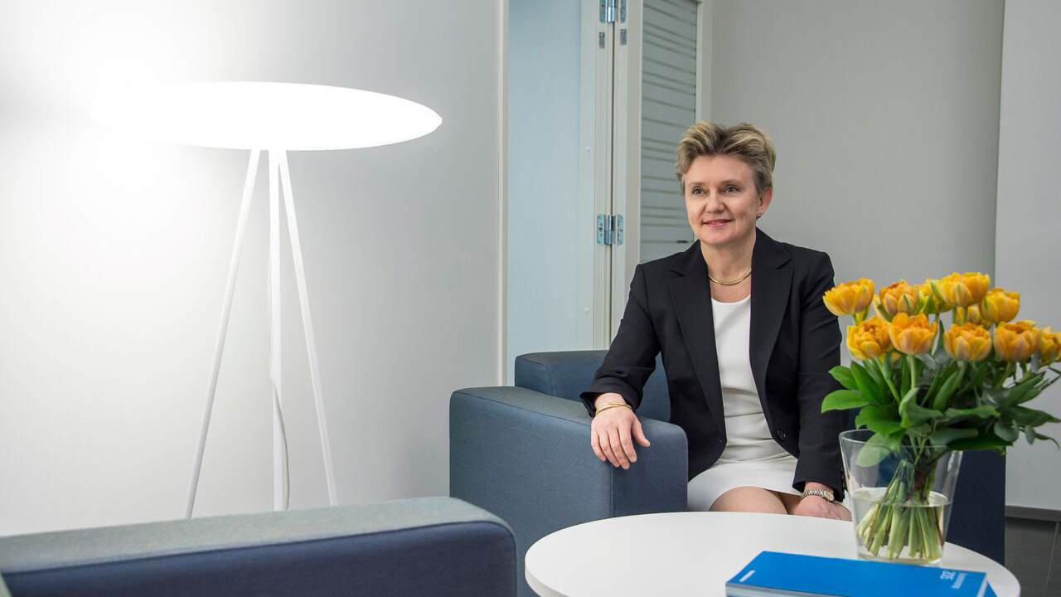
”At Handelsbanken, decentralised decision-making brings better results and increases customer satisfaction. As employees gain opportunities to make a difference, they readily take more responsibility.”
Handelsbanken

Slide 8
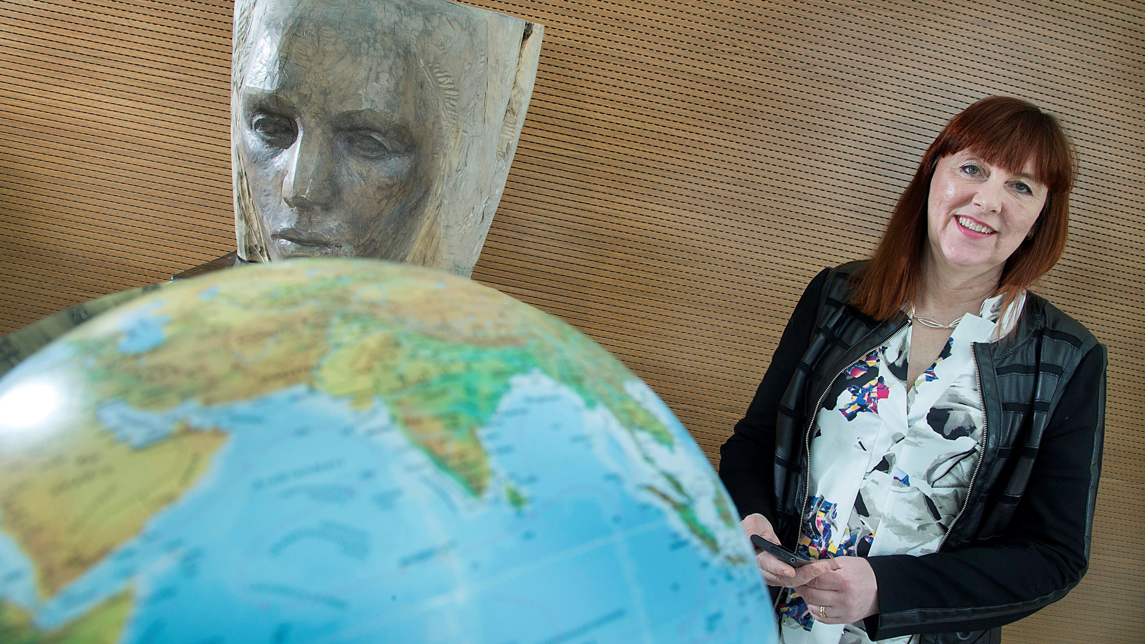
”We had training which discussed the stress factors of mobile work and how the tools of a digital environment could be used to reduce this stress. I received concrete tips on making daily life run more smoothly, as well as useful information on recovery!”
If P&C Insurance Company

Slide 9
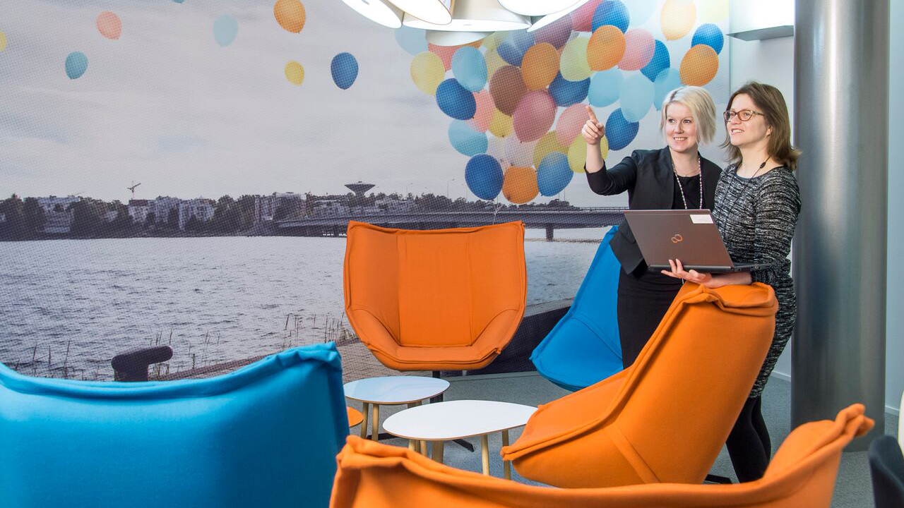
”Bravely combining skills and knowledge across company borders will create new thinking, energy and enthusiasm. Exactly what we need in today’s world.”
Ilmarinen Mutual Pension Insurance Company

Slide 10
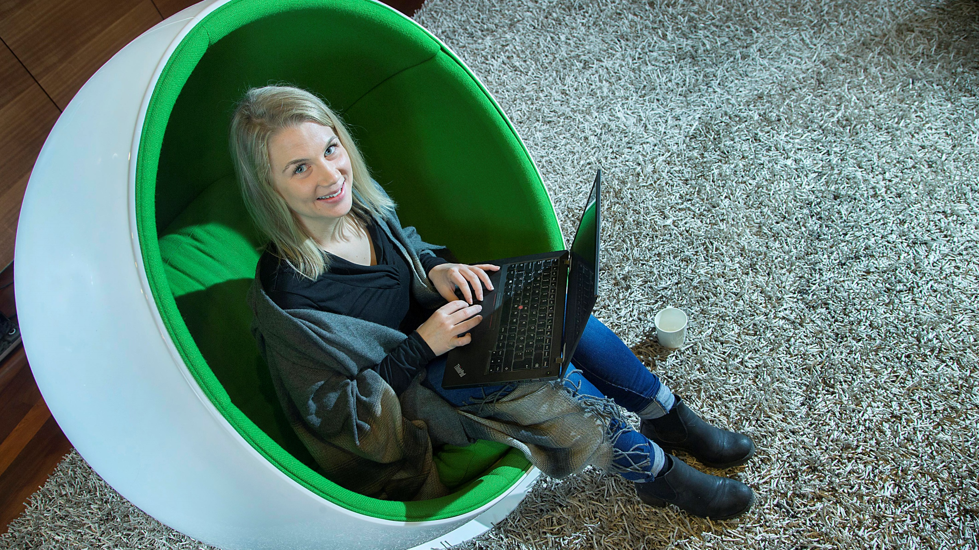
”At LocalTapiola, telework increases freedom, flexibility and trust. Happy employees work with enthusiasm and efficiency.”
LocalTapiola Group

Slide 11
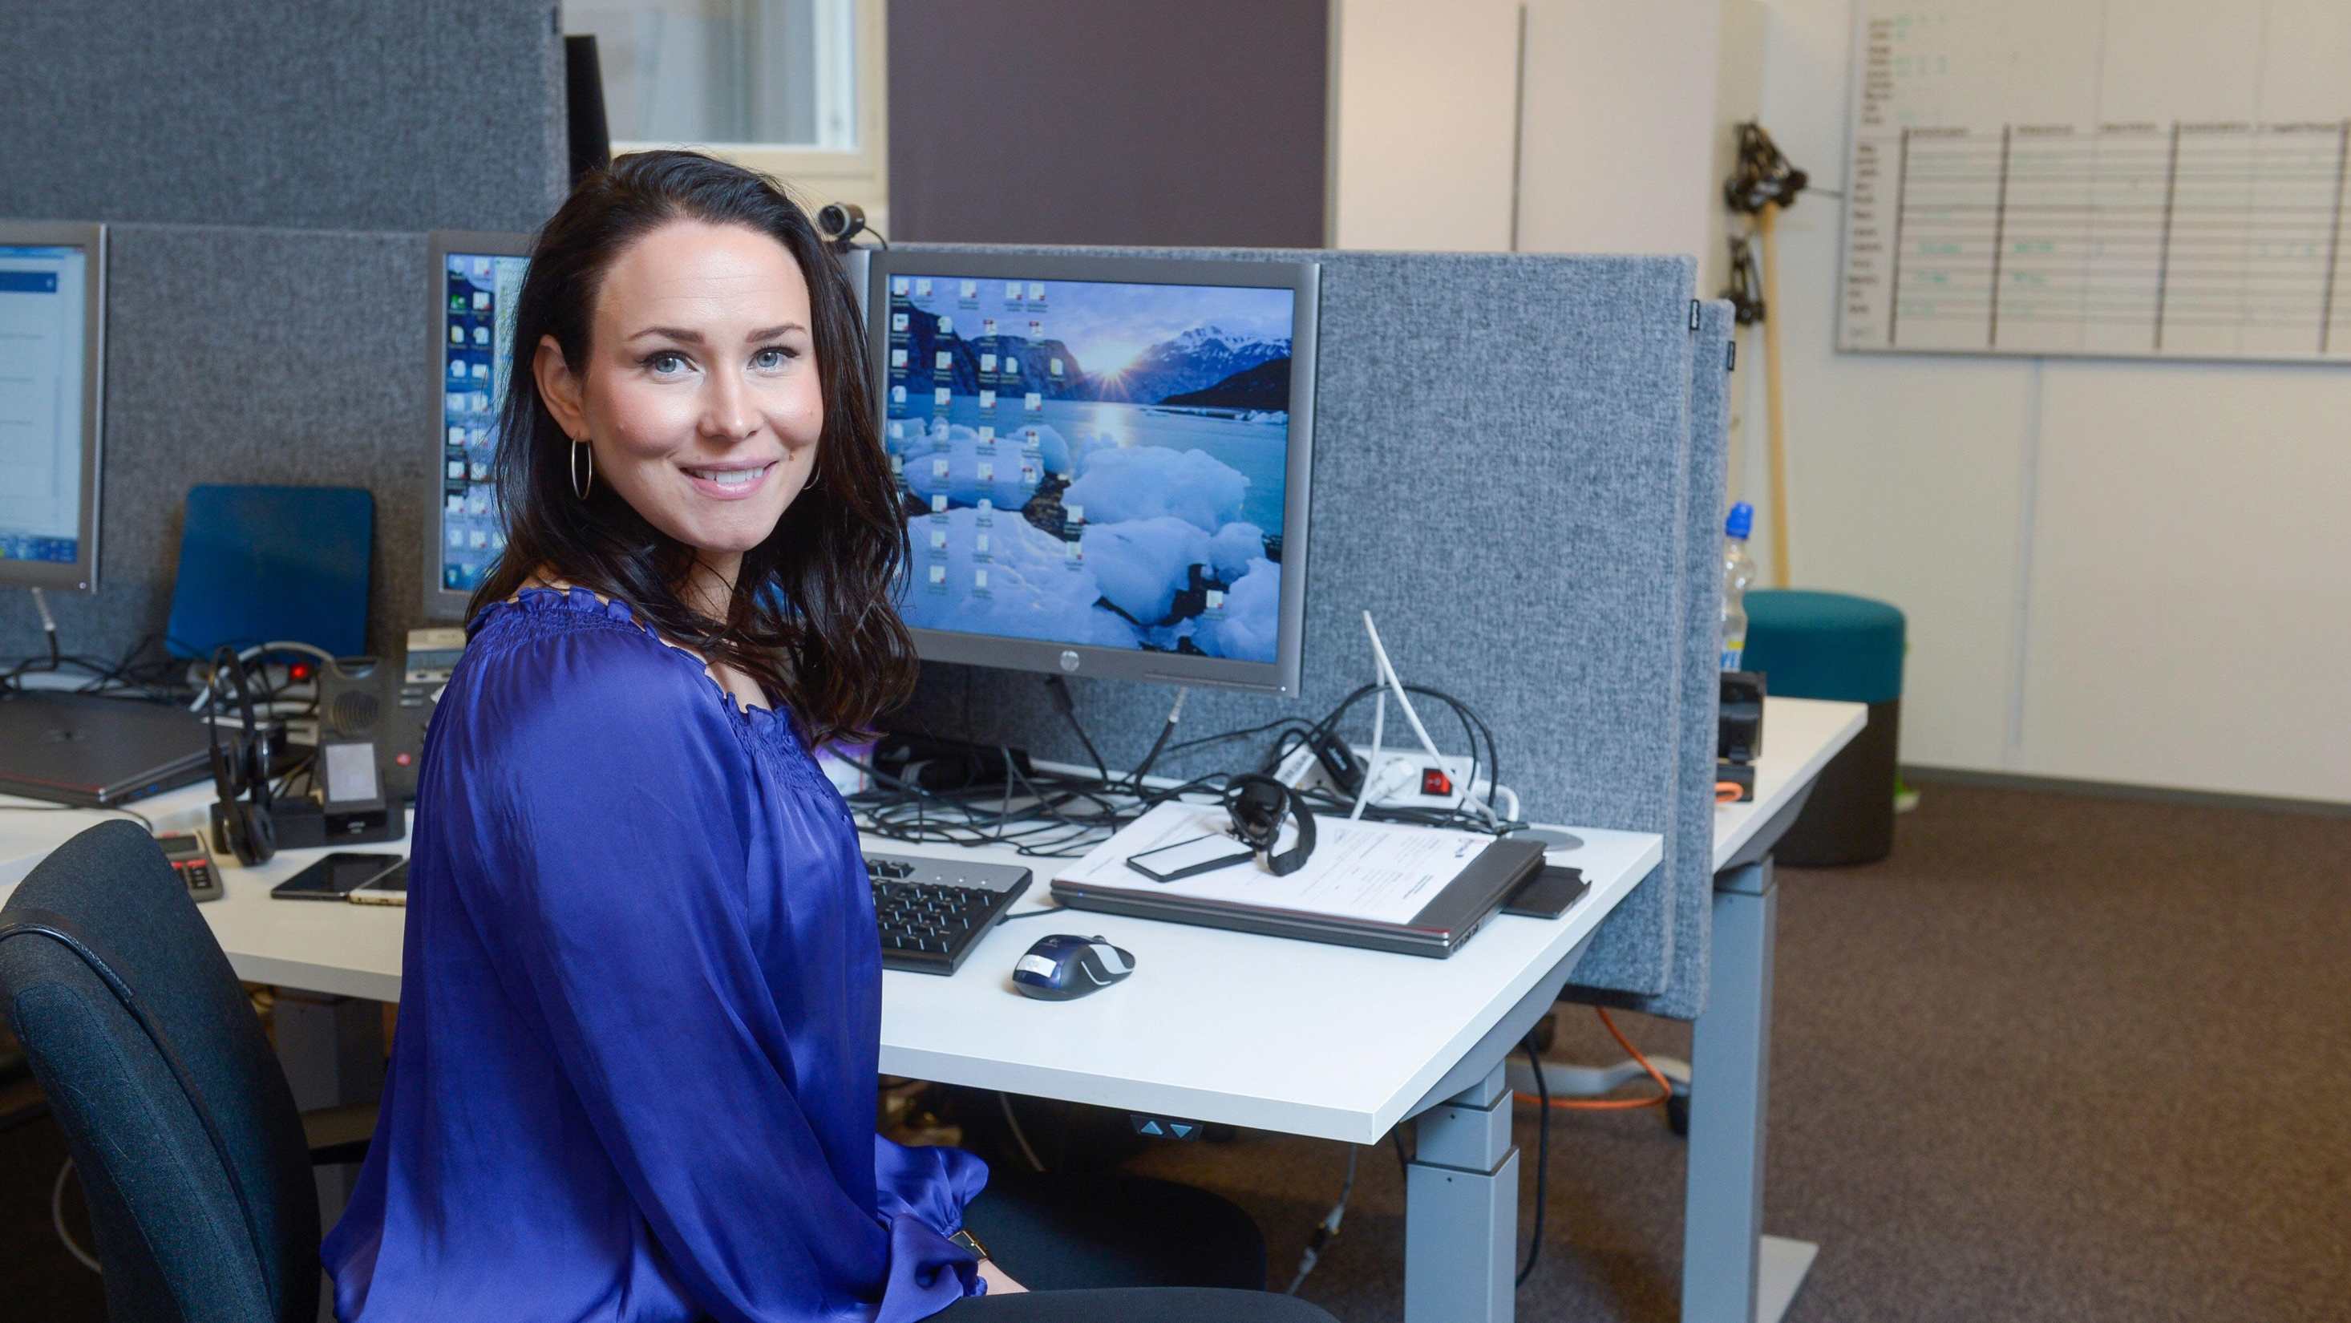
”Our customers are very happy with the service they get on Saturdays. It is difficult to find the time to go the bank on a weekday, and they appreciate the face to face service we provide.”
Nordea Bank

Slide 12
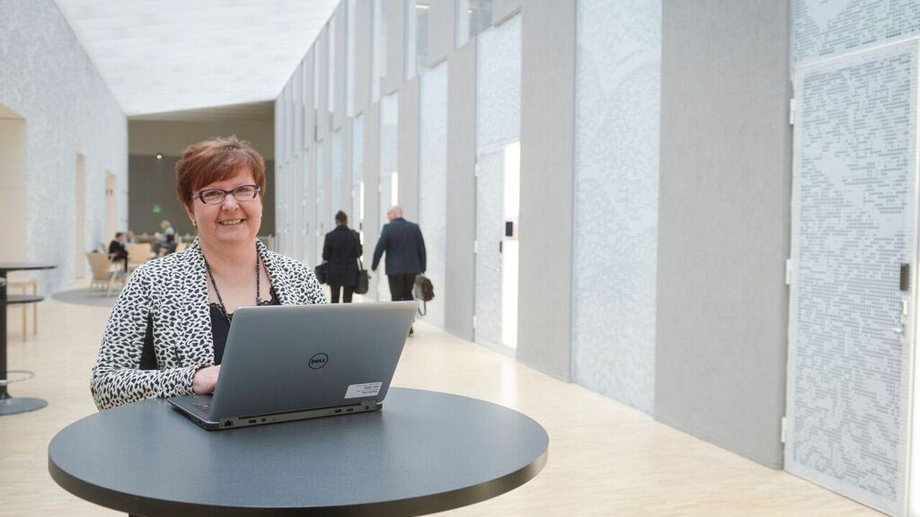
”The OP Group works in a new, more flexible way. The new operating model increases work wellbeing and, in extension, productivity.”
OP Financial Group

Slide 13
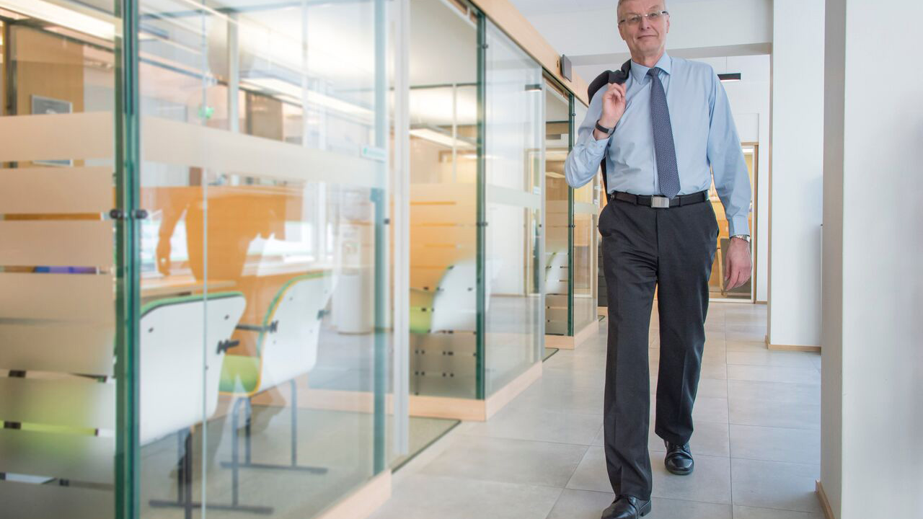
”Managerial work is actively leading people to their goals.”
Suupohja POP Bank

Slide 14
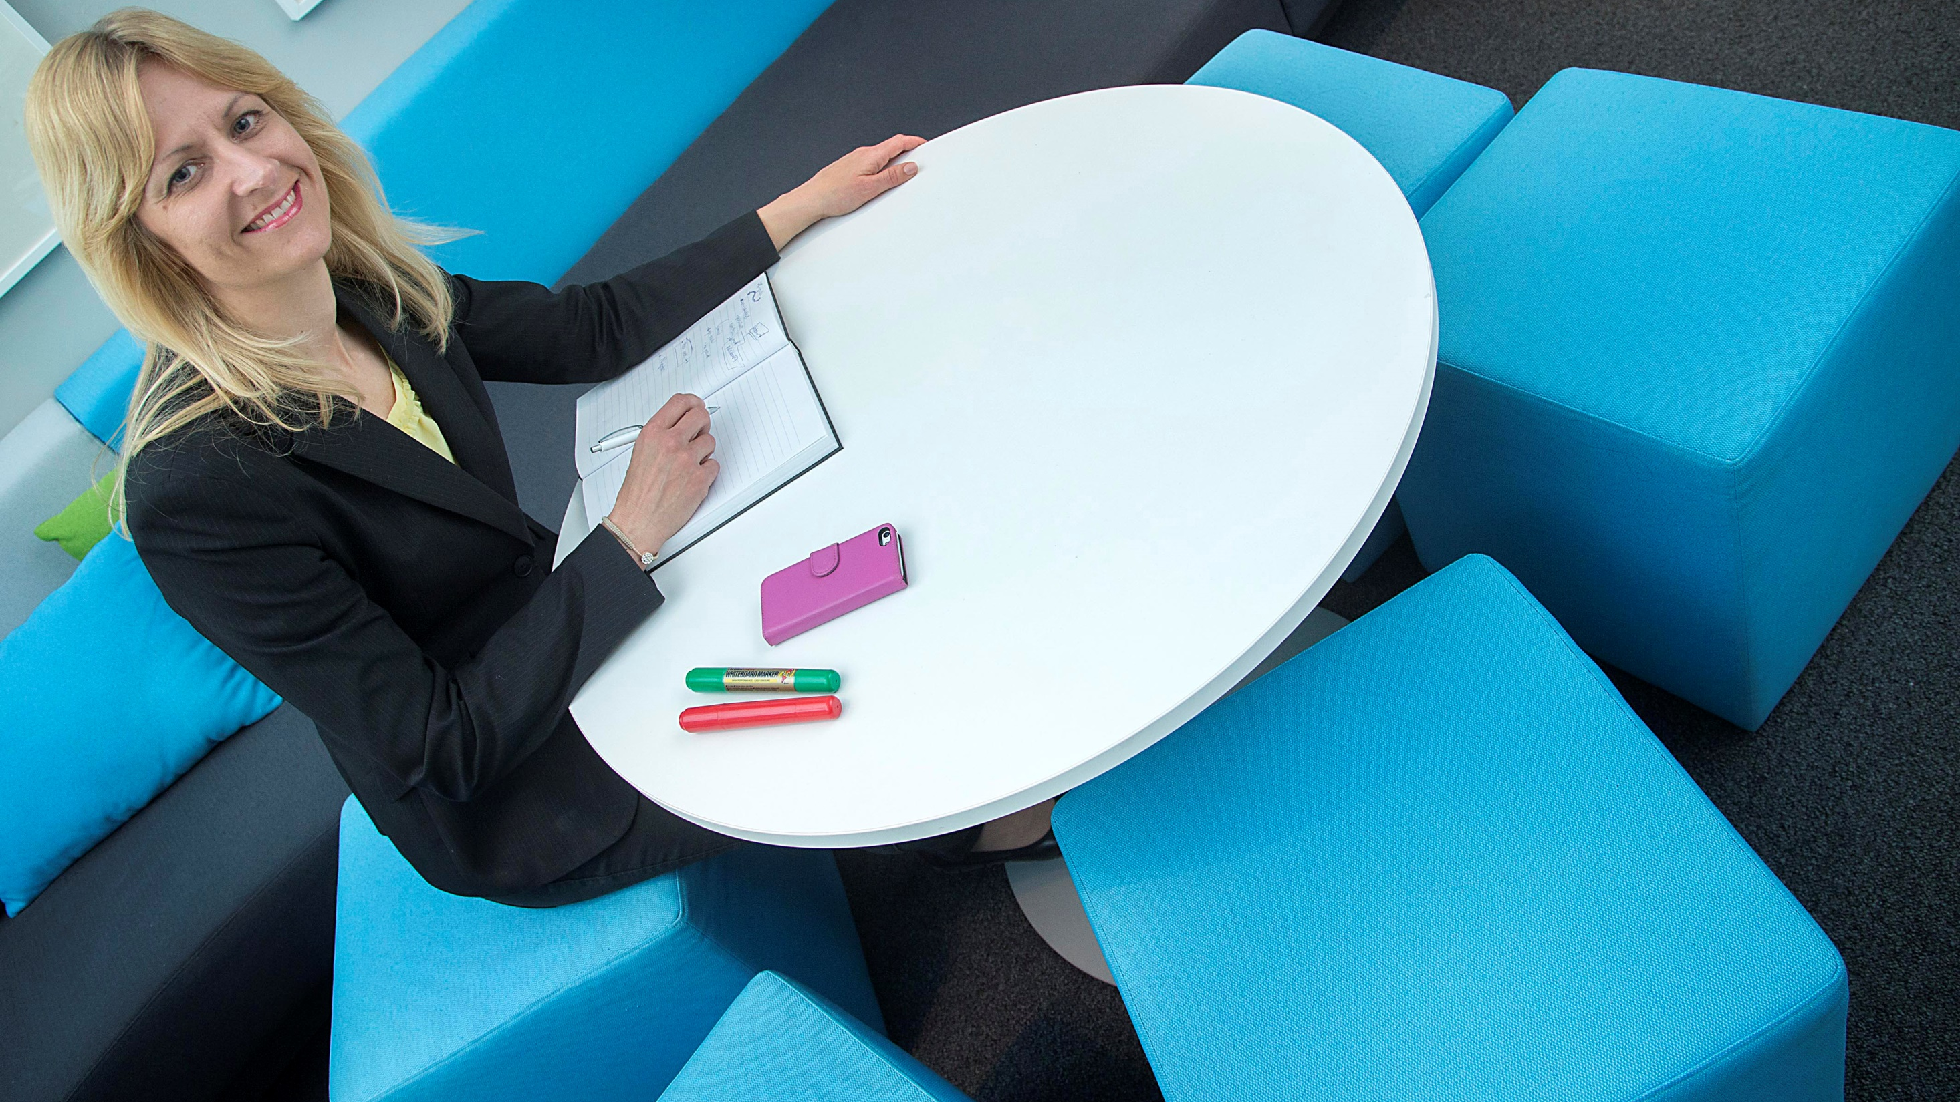
”The Savings Bank Group strengthens community spirit by using a facilitator in employee meetings. Inter-group information exchange has increased, the organisational culture grown stronger, and the best practices are now openly shared.”
Savings Bank Group

Slide 15
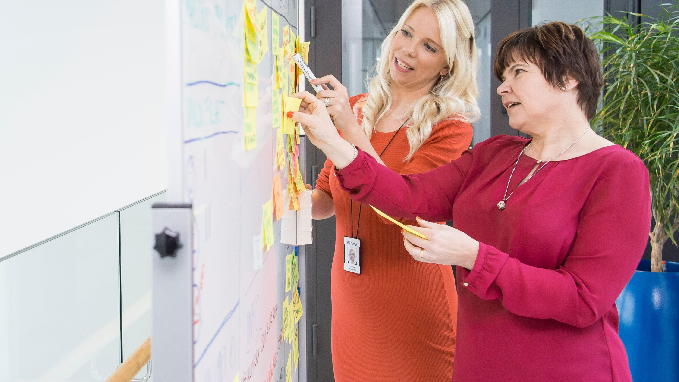
”In the Lean model we now have time and space to stop and bring the customer to focus. We gained permanent structures from the development process, some of which cross department borders.”
Varma Mutual Pension Insurance Company

Slide 16
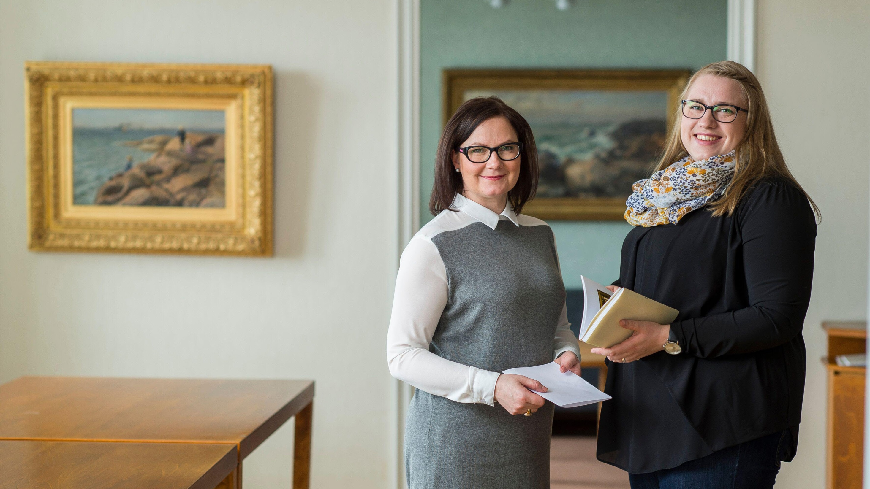
”Veritas’ high quality customer service would not be possible without a just and equal bonus system.”
Veritas Pension Insurance

