Slide 1
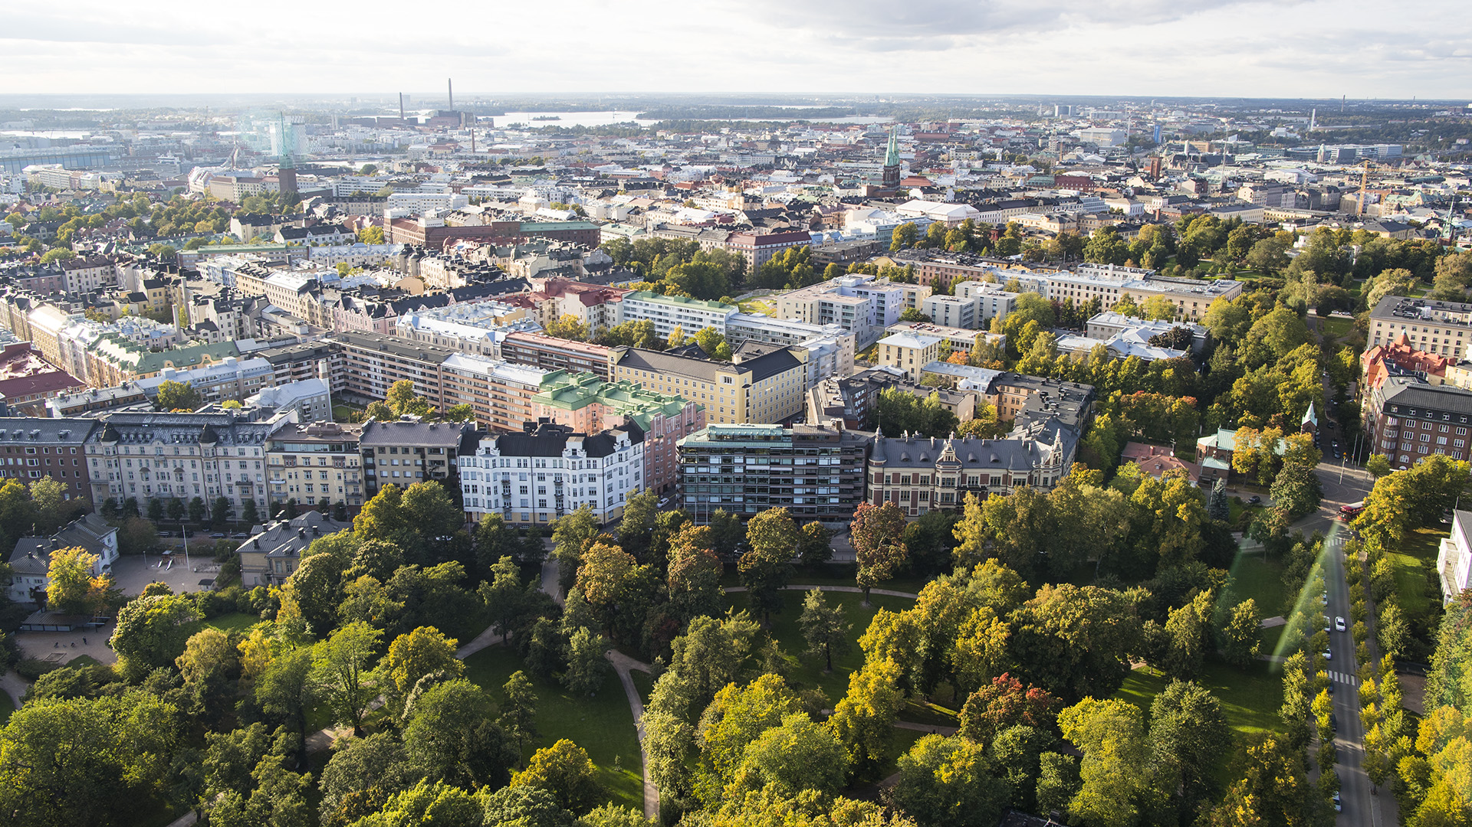
Finnish Financial Sector Personnel and Competence
2019 Finance Finland (FFI)

Slide 2
How work in the financial sector is changing
COMPETENCE
Globalisation
Digitalisation
Sector blurring, new participants
Regulation
Changing customer behaviour
Customers
Profitability
Result
Work

Slide 3
Personnel in Finnish banks and insurance companies

Slide 4
Financial sector personnel 2018 by age structure
Source: EK wage statistics

Slide 5
Financial sector personnel 2018 by occupation
Source: EK wage statistics

Slide 6
Women in the financial sector proportion by occupation
Source: EK wage statistics

Slide 7
More educated personnel educational background in 2000–2018
Source: EK wage statistics

Slide 8
Financial sector personnel 2018 degrees and qualifications other than business and economics
Proportion of business/economics degrees and qualifications
Banking 64% Insurance 55%
Source: EK wage statistics

Slide 9
Competitive wages average income by sector in September 2018
Source: EK wage statistics

Slide 10
Average monthly salaries in 2018
Source: EK wage statistics
The sums include regular working hours only (no bonuses).

Slide 11
TOP 5 skills and competencies
In September 2018, FFI conducted a survey to map the current and future skill requirements in the financial sector according to sector participants.
The objective of the “Top5” survey was to find out which of the 35 skill sets or characteristics listed were the most important.
The survey respondents included employees, managers, executives and representatives of educational institutions.
The total number of respondents was 656.
95 respondents worked in the insurance sector (64 women/31 men).
The age group 45-54 years had the highest representation (34%), followed by those 35-44 years old (30%).

Slide 12
All answers to the TOP5 skill requirements survey
Total 3,256

Slide 13
Future skill requirements
SELF-DIRECTION
SOCIAL SKILLS
DIGITALISATION
VALUE
Self-direction
Professional self-improvement
Adaptability
Awareness of own competence
Ability to manage personal well-being
Resilience
Empathy
Negotiating skills
Service skills
Social skills
Networking
Digital skills
Ability to process and utilise data
Ability to utilise technology
Customer experience skills
Ability to set and pursue goals
Business skills
Sales skills
46%
22%
15%
12%
International skills
Languages
Cultural knowledge
Understanding of global economy
INTERNATIONALITY
3.5%

Slide 14
Change (%) in the number of banking sector employees in 2007–2016

