Slide 1
Personnel and Future Skill Requirements in the Financial Sector

Slide 2
Are we prepared for the digital revolution?
Sectors transform, jobs disappear – but new opportunities also arise. New operating models, innovations and ways of working.
Skills and competencies play a key role in the future. The most important skill is the ability to learn.
The vision of the future needs to be created together with employees. Lifelong learning, the responsibility for training is shared between the employees, the employers and the government.

Slide 3
Megatrends affecting the financial sector? How is the operating environment changing?
Digitalisation, globalisation and ageing population are already reality
Robotics, AI and big data create ethical challenges
Integrating business sectors, increasing competition, new challengers from new sectors
Environment and responsibility are becoming stronger trends
Increasing regulation
Security and decreasing use of cash
Changing customer expectations, competition through customer service experience
Source: Financial Academy 2018

Slide 4
Financial sector’s new way of operating
Market changes and new players
Changing customers
Evolution of work, new skill requirements
Work well-being and leadership
Productivity, competitiveness and new operating models

Slide 5
Financial personnel in Finland

Slide 6
Age structure of financial services personnel in 2017
Source: EK wage statistics

Slide 7
More educated people are hired educational background, %
Source: EK wage statistics

Slide 8
Future Skills Survey 2018
Conducted in autumn 2018 as one of several ways to predict the future and determine the types of training employees and students should receive.
656 responses from financial sector experts, students and teachers
355 educators
192 banking
95 insurance
14 other
499 women, 146 men, 11 other
largest age group 45–54 years (29%), second 35–44 years (26%)

Slide 9
TOP skill requirements, all responses (3256)

Slide 10
Areas of focus in the future
SELF-DIRECTION
SOCIAL SKILLS
DIGITALISATION
VALUE
Self-direction
Professional self-improvement
Adaptability
Recognition of own strengths
Ability to manage personal well-being
Ability to work under pressure
Empathy
Negotiating skills
Service skills
Social skills
Social networking
Digital skills
Processing and utilising data
Ability to utilise technology
Customer experience skills
Ability to set and pursue goals
Business skills
Sales skills
International skills
Languages
Cultural knowledge
Understanding global economy
INTERNATIONALITY

Slide 11
Selection criteria for workplaces in 2018
Source: T-Media survey on employer image 2018

Slide 12
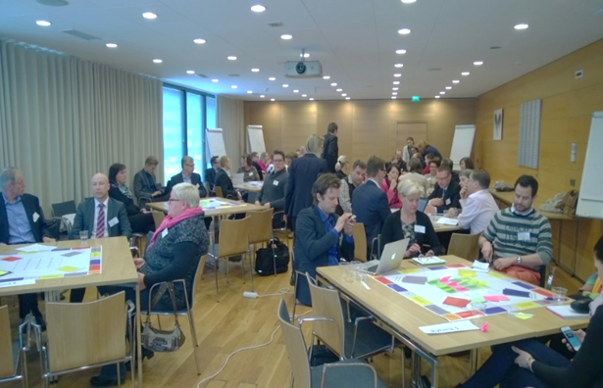
Co-operation with Unions: Concrete actions
2014–2015: Healthy Financial Sector project
financial sector’s new way of operating
2016: Words to Actions – best practices of Finnish financial sector companies
Compilation of the financial sector’s best practices, including new telework practices, decentralised decision-making, and trial runs with Saturday work
Case IF: Healthy Financial Sector’s results in local use
2017: New way of working – wellbeing and productivity through trust
Tools, like worksheet in local co-operation
Co-operation for 2018–2020 is also included in our new collective agreements. Healthy Financial Sector project continues
High priority for future skills and competences, main topics are digitalization, robotics and artificial intelligence.
Improving co-operation at workplaces. Employees’ own motivation

Slide 13
Financial sector’s 3 targets for education
Education should react rapidly to the changes in working life.
Education should change from long, degree-oriented programmes to shorter units, more focused on specific skills.
More financial training should be included on all educational levels. This training should include business skills, entrepreneurship, customer service and the management of personal finances.

Slide 14
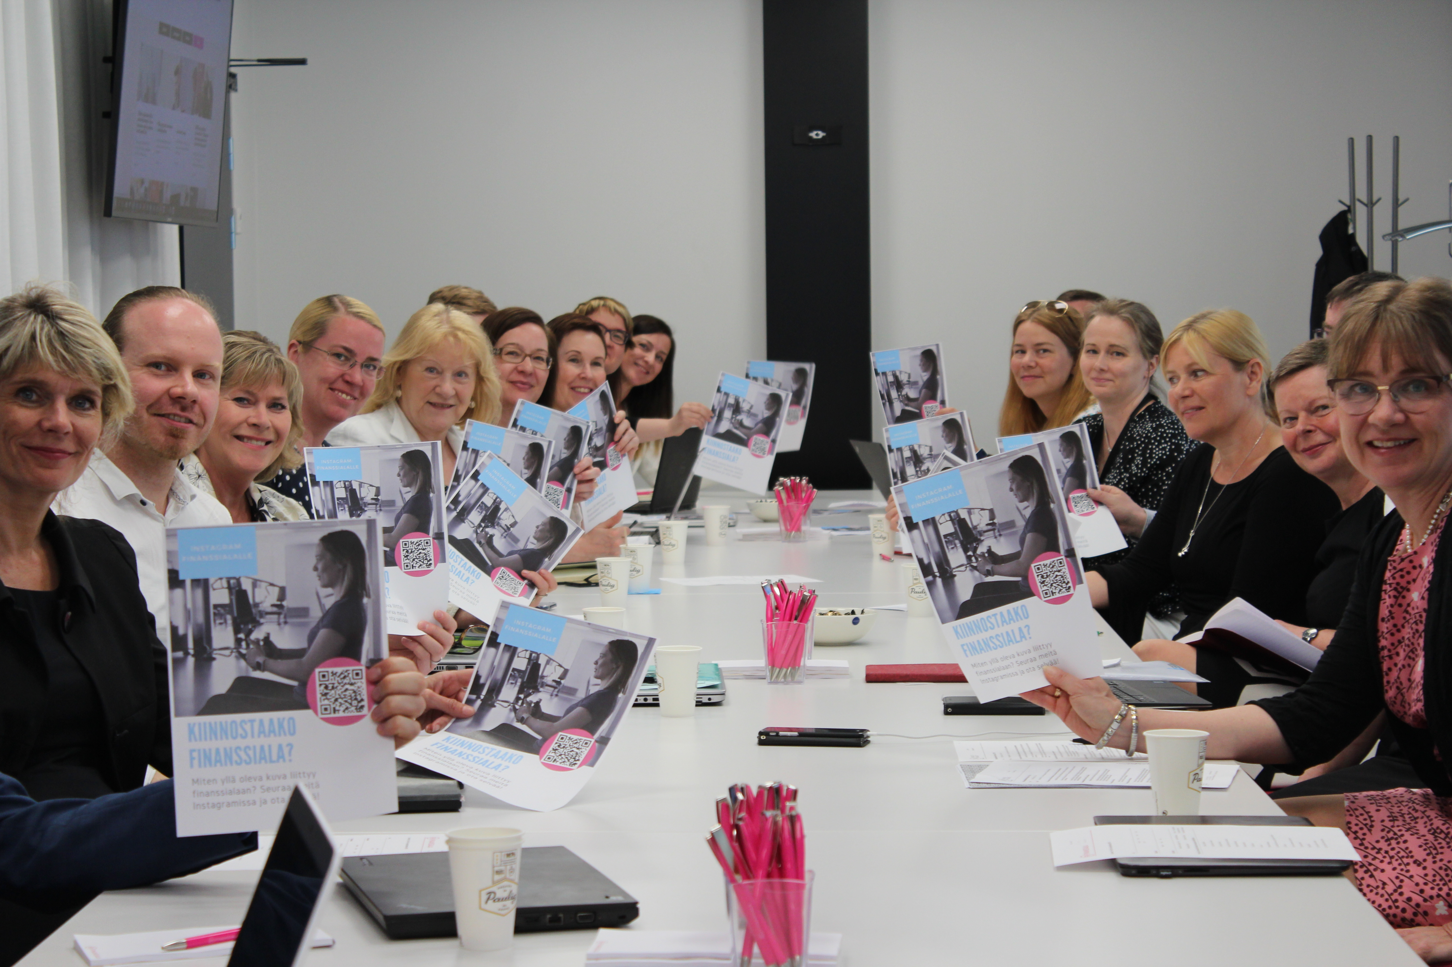
Financial Academy: shaping education and raising the financial sector’s profile

Slide 15
Financial Academy, networking and collaboration
Work is changing rapidly – current education system is too slow.
New skills and competencies are in high demand.
Strong support from our members.
Educational institutions– the Financial Academy currently involves 14 universities, universities of applied sciences and vocational schools.
Partnership contracts increase networking.

Slide 16
Financial Academy combines education and working life
Collaboration and practical work take place through three working groups. Each group has representatives from FFI member organisations and different educational institutions.
Representing industry interests in education – lobbying and collaboration with educational authorities
Training paths and employer image – for current and future employees, attractiveness of the sector, employer image, social responsibility
Digital learning materials – assessment, production, utilisation and sharing of existing study materials on topics such as the fundamentals of finance, legal matters and customer service

