Slide 1
FINNISH INSURANCE IN 2022

Slide 2
GROSS PREMIUMS WRITTEN IN FINLAND

Slide 3
BREAKDOWN OF GROSS PREMIUMS WRITTEN BY FINNISH INSURERS

Slide 4
CLAIMS PAID BY FINNISH INSURERS

Slide 5
NUMBER OF INSURERS OPERATING IN FINLAND

Slide 6
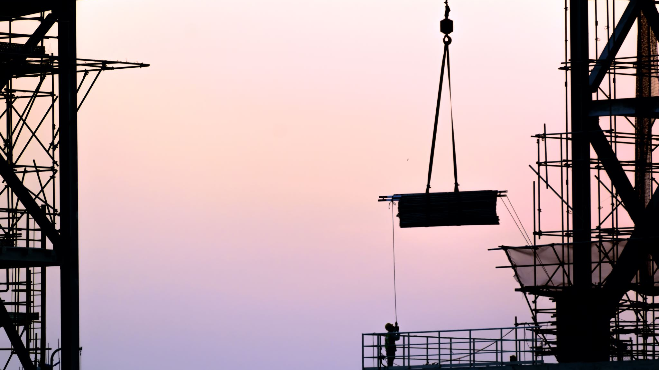
NON-LIFE INSURANCE

Slide 7
BREAKDOWN OF NON-LIFE BUSINESS

Slide 8
NON-LIFE INSURERS’ MARKET SHARES IN 2022 Gross direct premiums written in Finland total €4,948 million

Slide 9
NON-LIFE INSURERS’ TECHNICAL PROVISIONS

Slide 10
NON-LIFE INSURANCE RATIOS

Slide 11
LOSS RATIO, NET OF REINSURANCE

Slide 12
LIFE INSURANCE

Slide 13
LIFE INSURANCE PREMIUMS WRITTEN

Slide 14
LIFE INSURANCE PREMIUMS WRITTEN

Slide 15
BREAKDOWN OF LIFE BUSINESS IN 2022
Total €4.4 billion

Slide 16
LIFE INSURERS’ MARKET SHARES IN 2022

Slide 17
INVESTMENTS

Slide 18
FINNISH INSURERS’ INVESTMENTS at current values

Slide 19
NET INCOME ON INVESTMENTS AT CURRENT VALUE % of capital employed

Slide 20
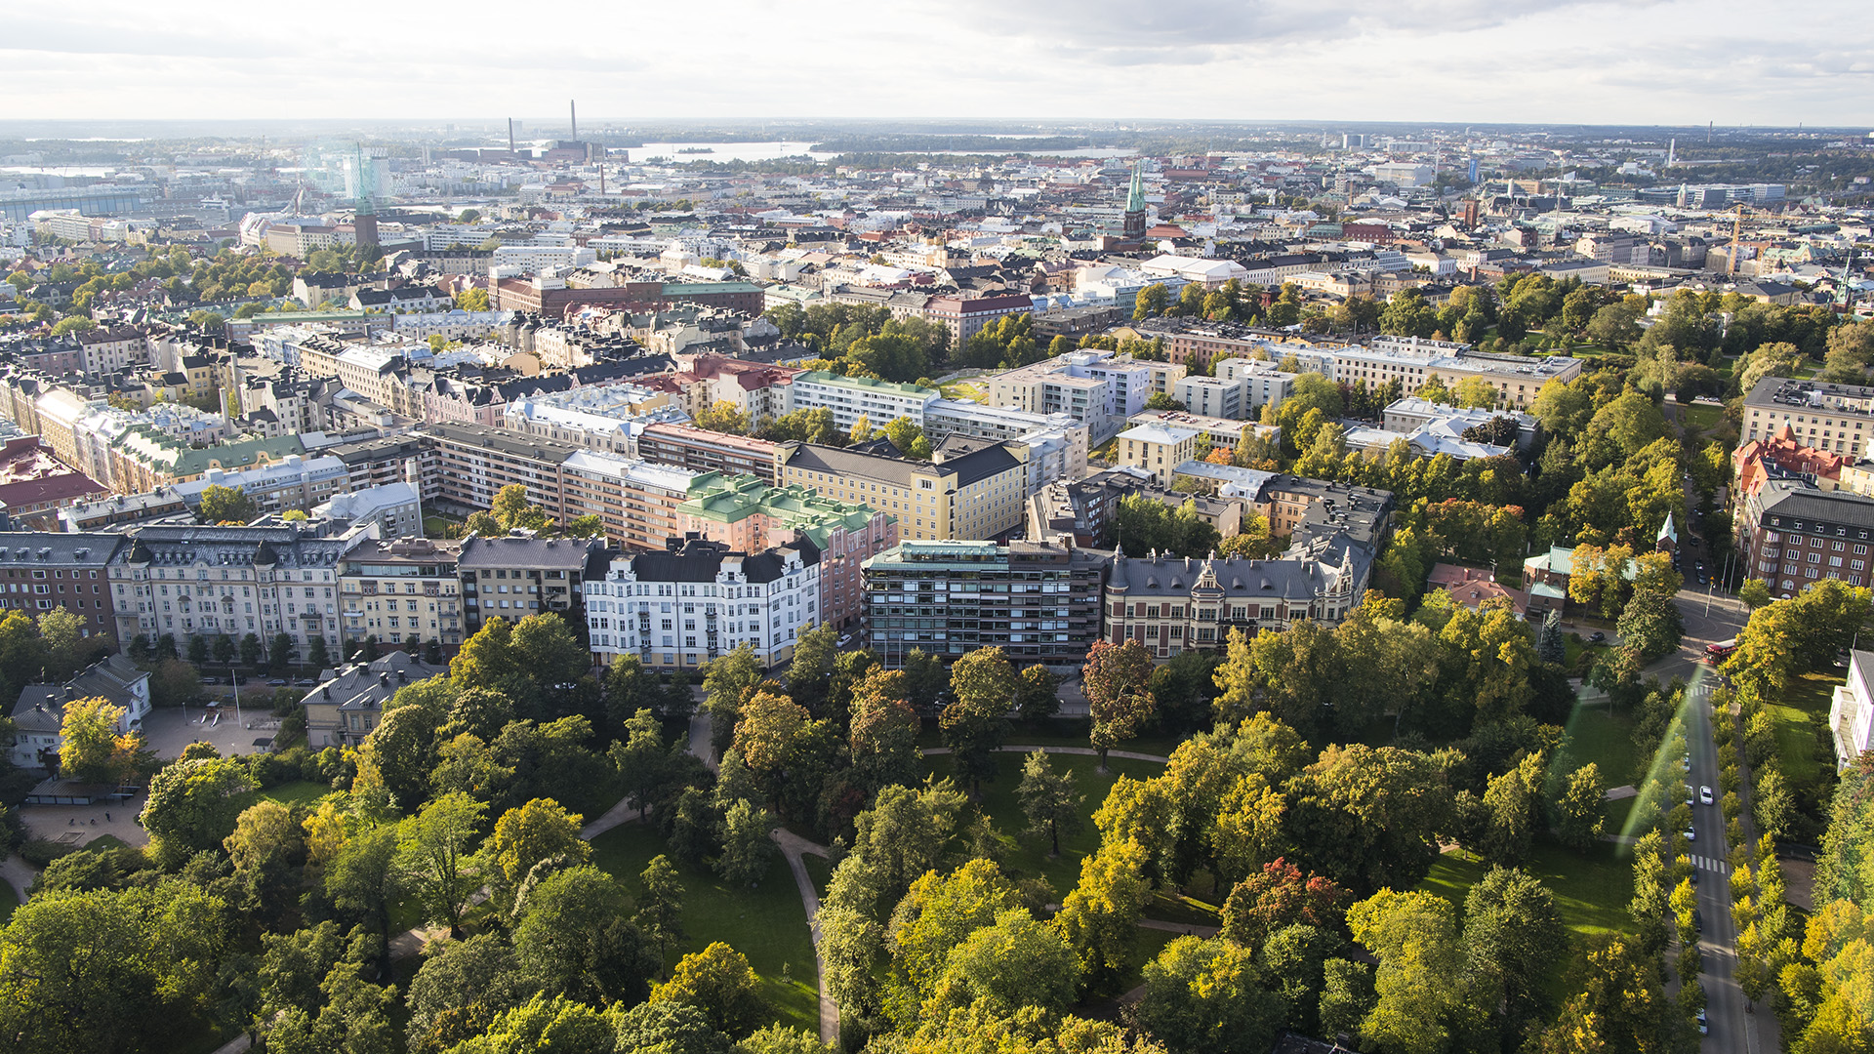
Finanssiala.fi
@finfinance
Finanssiala ry
Finanssiala ry
@finanssiala

