Slide 1

FINNISH
INSURANCE
IN 2023

Slide 2
GROSS PREMIUMS WRITTEN IN FINLAND

Slide 3
BREAKDOWN OF GROSS PREMIUMS WRITTEN
BY FINNISH INSURERS

Slide 4
CLAIMS PAID BY FINNISH INSURERS

Slide 5
NUMBER OF INSURERS OPERATING IN FINLAND

Slide 6

NON-LIFE
INSURANCE

Slide 7
BREAKDOWN OF NON-LIFE BUSINESS

Slide 8
NON-LIFE INSURERS’ MARKET SHARES IN 2023
Gross direct premiums written in Finland total €5,155 million

Slide 9
NON-LIFE INSURERS’ TECHNICAL PROVISIONS

Slide 10
NON-LIFE INSURANCE RATIOS

Slide 11
LOSS RATIO, NET OF REINSURANCE

Slide 12

LIFE INSURANCE

Slide 13
LIFE INSURANCE PREMIUMS WRITTEN

Slide 14
LIFE INSURERS’ MARKET SHARES IN 2023

Slide 15
LIFE INSURANCE PREMIUMS WRITTEN

Slide 16
BREAKDOWN OF LIFE BUSINESS IN 2023
Total €4.6 billion

Slide 17

STATUTORY EMPLOYEE PENSION INSURANCE

Slide 18
Employee pension insurers’ MARKET SHARES IN 2023 premiums written total €18,410 million

Slide 19
Employee pension insurance premiums written and pensions paid

Slide 20

INVESTMENTS

Slide 21
FINNISH INSURERS’ INVESTMENTS at current values

Slide 22
NET INCOME ON INVESTMENTS AT CURRENT VALUE
% of capital employed

Slide 23
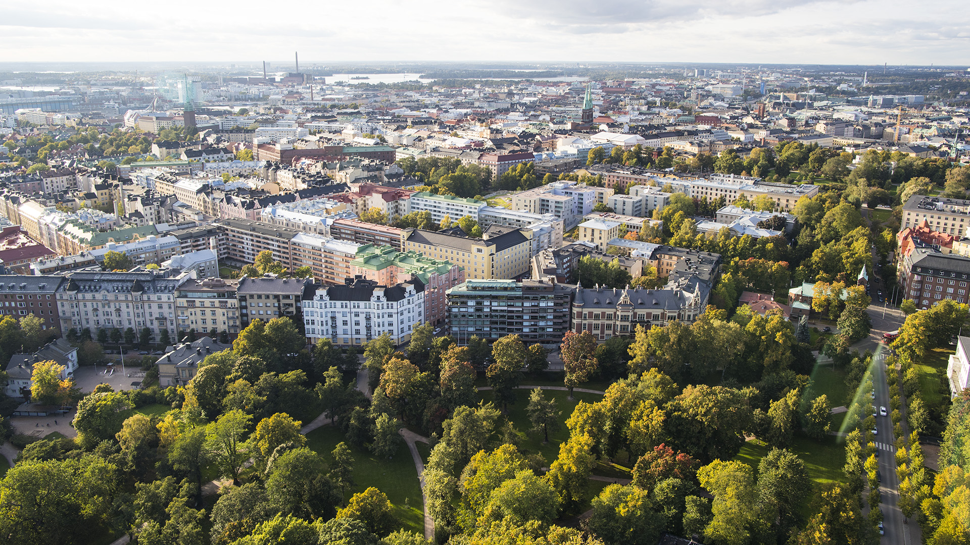





  Finanssiala.fi
  @finfinance
  Finanssiala ry
  Finanssiala ry
  @finanssiala

