Slide 1
Sijoitusrahastomarkkinoiden kehitys
30.6.2025

Slide 2
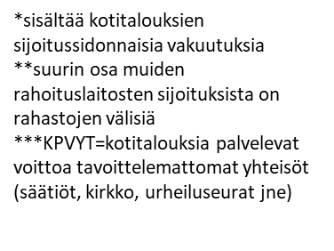
Rahastopääoman jakautuminen omistajasektoreittain 31.12.2022
Lähde: Suomen Pankki ja FA

Slide 3
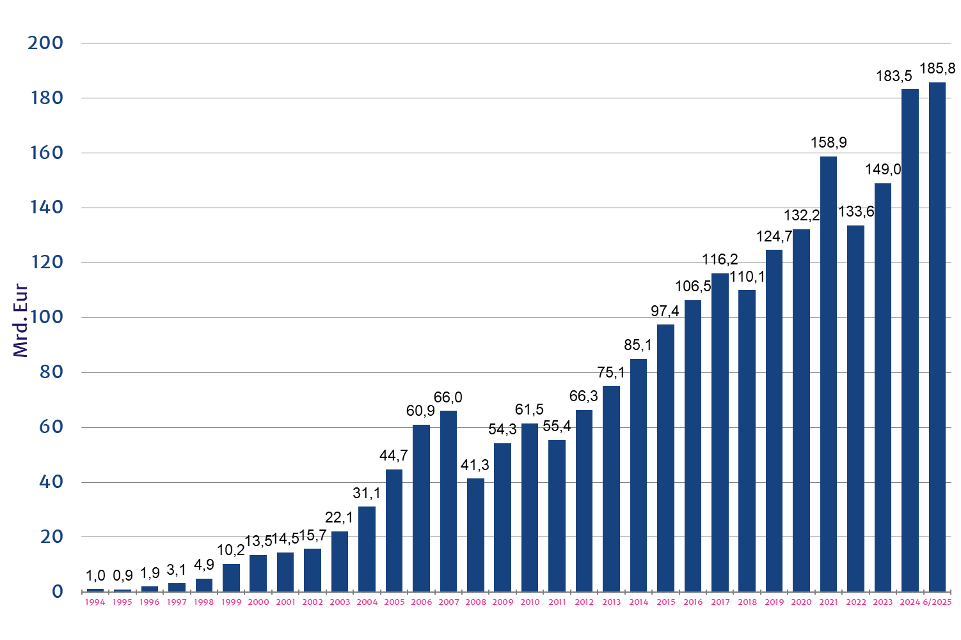
Rahastopääoma suomalaisissa sijoitusrahastoissa

Slide 4
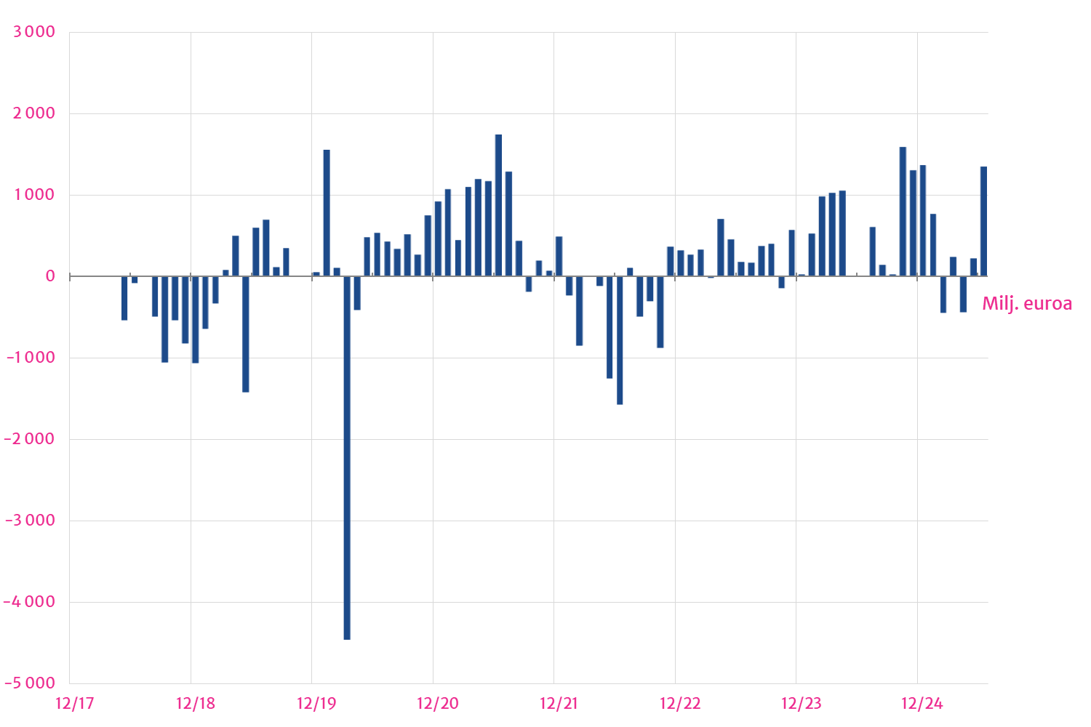
Nettomerkinnät suomalaisissa sijoitusrahastoissa

Slide 5
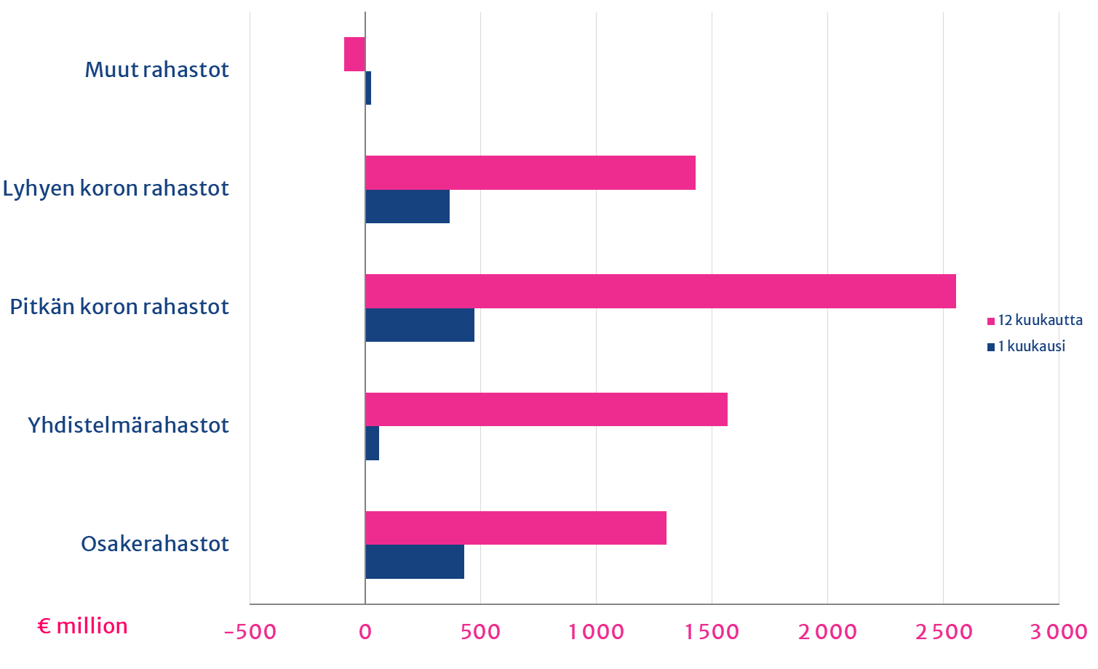
Nettomerkinnät rahastoluokittain

Slide 6
Osakerahastojen nettomerkinnät rahastoluokittain

Slide 7
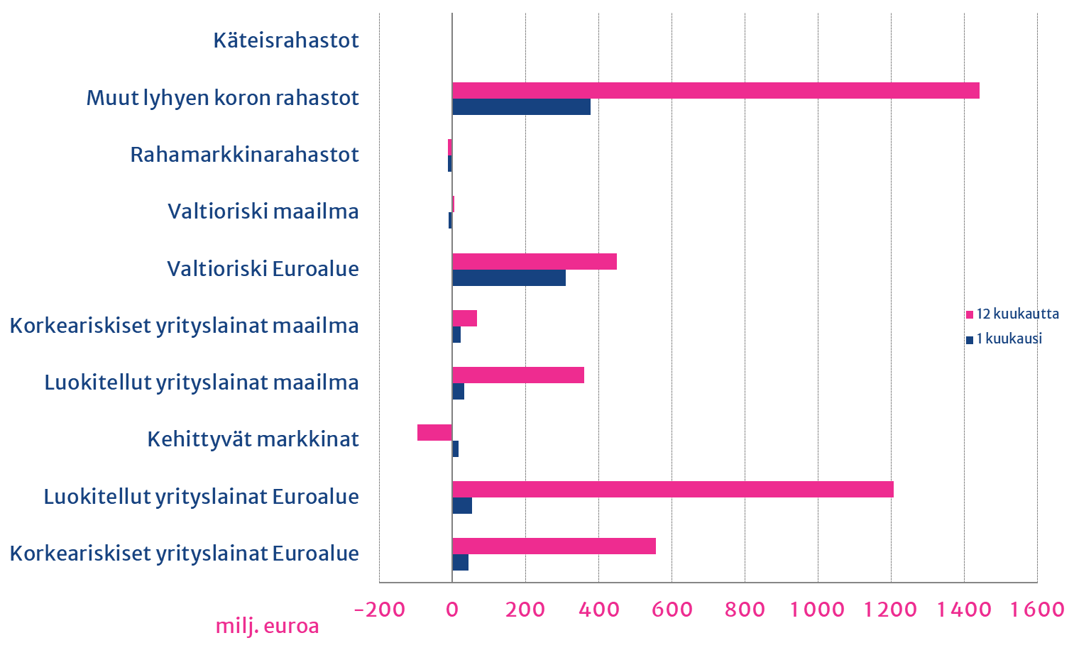
Korkorahastojen nettomerkinnät rahastoluokittain

Slide 8
Rahastopääoman jakautuminen Suomessa

Slide 9
Rahastopääomien ja kumulatiivisten nettomerkintöjen kehittyminen

Slide 10
Suomalaisten osakerahastojen ESG -jakaumat
ESG Data Provided by MSCI ESG Research LLC
*Certain information contained herein (the “Information”) has been provided by MSCI ESG Research LLC, a Registered Investment Adviser under the Investment Advisers Act of 1940, and may include data from its affiliates (including MSCI Inc. and its subsidiaries (“MSCI”)), or third party suppliers (each an “Information Provider”), and it may not be reproduced or redisseminated in whole or in part without prior written permission. The Information has not been submitted to, nor received approval from, the US SEC or any other regulatory body. The Information may not be used to create any derivative works, or in connection with, nor does it constitute, an offer to buy or sell, or a promotion or recommendation of, any security, financial instrument or product or trading strategy, nor should it be taken as an indication or guarantee of any future performance, analysis, forecast or prediction. Some funds may be based on or linked to MSCI indexes, and MSCI may be compensated based on the fund’s assets under management or other measures. MSCI has established an information barrier between equity index research and certain Information. None of the Information in and of itself can be used to determine which securities to buy or sell or when to buy or sell them. The Information is provided “as is” and the user of the Information assumes the entire risk of any use it may make or permit to be made of the Information. Neither MSCI ESG Research nor any Information Party makes any representations or express or implied warranties (which are expressly disclaimed), nor shall they incur liability for any errors or omissions in the Information, or for any damages related thereto.

Slide 11
Suomalaisten pitkän koron rahastojen ESG -jakaumat
ESG Data Provided by MSCI ESG Research LLC
*Certain information contained herein (the “Information”) has been provided by MSCI ESG Research LLC, a Registered Investment Adviser under the Investment Advisers Act of 1940, and may include data from its affiliates (including MSCI Inc. and its subsidiaries (“MSCI”)), or third party suppliers (each an “Information Provider”), and it may not be reproduced or redisseminated in whole or in part without prior written permission. The Information has not been submitted to, nor received approval from, the US SEC or any other regulatory body. The Information may not be used to create any derivative works, or in connection with, nor does it constitute, an offer to buy or sell, or a promotion or recommendation of, any security, financial instrument or product or trading strategy, nor should it be taken as an indication or guarantee of any future performance, analysis, forecast or prediction. Some funds may be based on or linked to MSCI indexes, and MSCI may be compensated based on the fund’s assets under management or other measures. MSCI has established an information barrier between equity index research and certain Information. None of the Information in and of itself can be used to determine which securities to buy or sell or when to buy or sell them. The Information is provided “as is” and the user of the Information assumes the entire risk of any use it may make or permit to be made of the Information. Neither MSCI ESG Research nor any Information Party makes any representations or express or implied warranties (which are expressly disclaimed), nor shall they incur liability for any errors or omissions in the Information, or for any damages related thereto.

Slide 12
Keskuspankkien taseet
Indeksi 2015=100

Slide 13
Keskuspankkien ohjauskorkoja
%

Slide 14
Lyhyet korot euroalueella
%

Slide 15
Keskeisten osakeindeksien kehitys
hintaindeksit, 1.1.2019=100

Slide 16
Pohjoismaat ja Eurooppa, osakeindeksit
hintaindeksit, 1.1.2019=100, paikallisissa valuutoissa

Slide 17
Kehittyvät taloudet, osakeindeksejä
MSCI, hintaindeksit EUR, 1.1.2019=100

Slide 18
Kiinan osakemarkkinat
kokonaistuotot, paikallisessa valuutassa

Slide 19
Osakeindeksien kehitys, kehittyvät taloudet vs. maailma
MSCI hintaindeksit, 2019=100, paikalliset valuutat

Slide 20
USA – osakemarkkinoiden pitkän aikavälin arvostustaso

Slide 21
Osakemarkkinoiden volatiliteetti
indeksi

Slide 22
Valtioiden 10v. jvk-lainojen korkoja
%

Slide 23
USA – valtionlainojen 2v. ja 10v. korot
%

Slide 24
Euroalueen yrityslainojen riskilisä
%

Slide 25
Euron dollari- ja jenikurssi

